Slide 1

John 17.13-19
Sent to
Do Something
BIG
- A World Mission -

Slide 2

Who Doesn’t Want to Do Something BIG?
This Photo by Unknown Author is licensed under CC BY-NC-ND

Slide 3

Yeah, right.
This Photo by Unknown Author is licensed under CC BY

Slide 4

Is there a cause that is truly fulfilling…?
This Photo by Unknown Author is licensed under CC BY-NC-ND
This Photo by Unknown Author is licensed under CC BY

Slide 5
Knowing God and being known by Him. Being used to tell the whole world how great He is!
This Photo by Unknown Author is licensed under CC BY-NC-ND
This Photo by Unknown Author is licensed under CC BY

Slide 6
John 17.13-19
I am coming to you now, but I say these things while I am still in the world, so that they may have the full measure of my joy within them. I have given them your word and the world has hated them, for they are not of the world any more than I am of the world. My prayer is not that you take them out of the world but that you protect them from the evil one. They are not of the world, even as I am not of it. Sanctify them by the truth; your word is truth. As you sent me into the world, I have sent them into the world. For them I sanctify myself, that they too may be truly sanctified

Slide 7
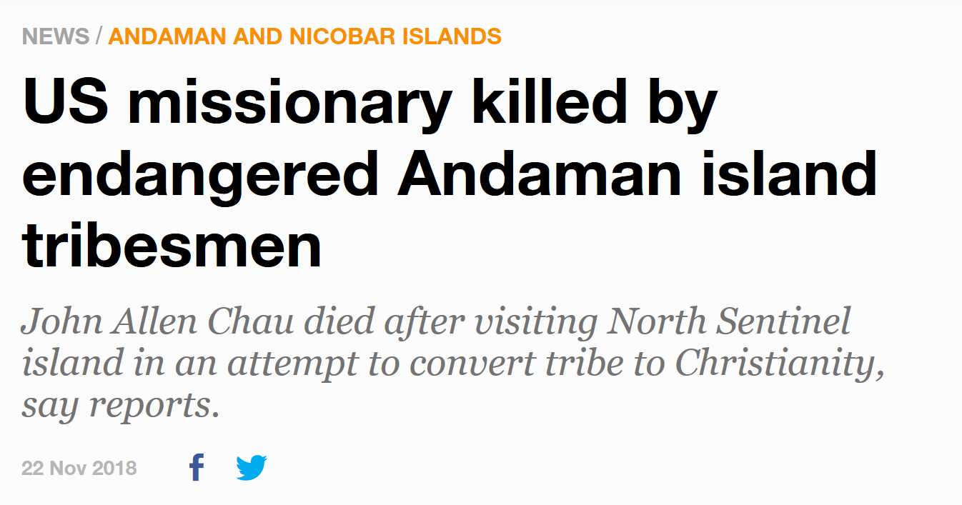
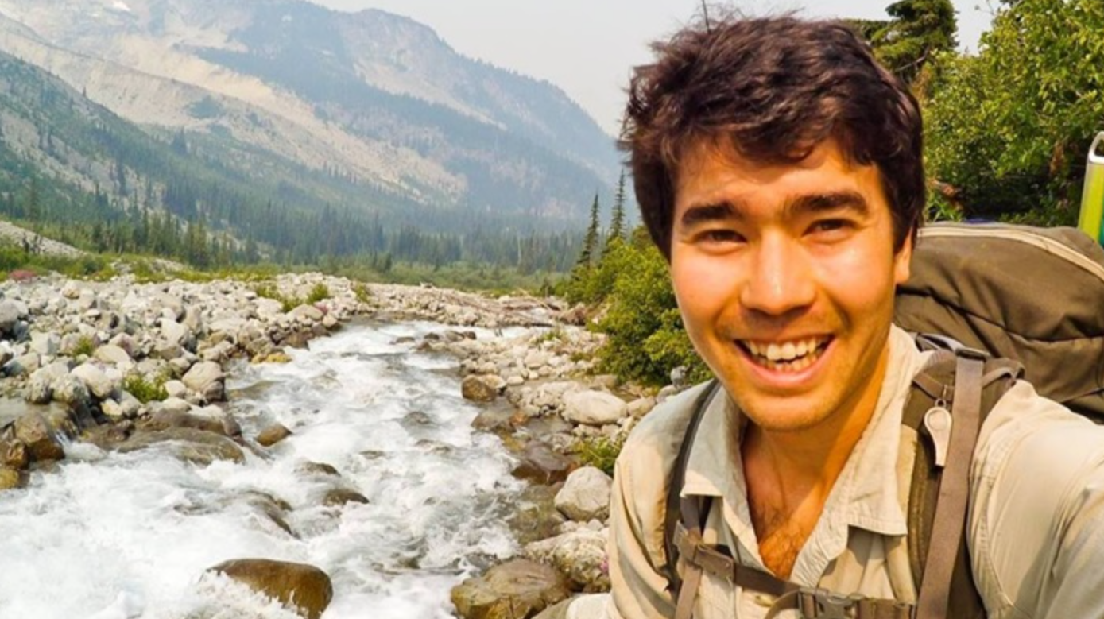
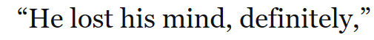
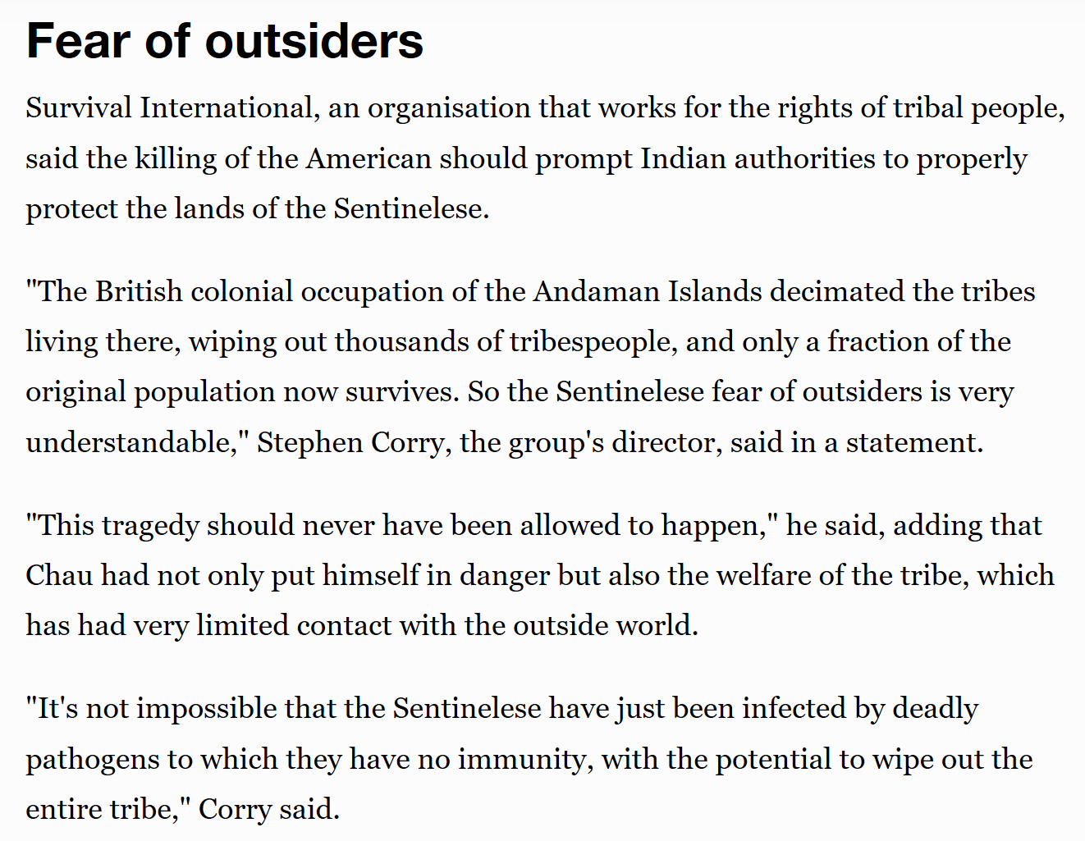
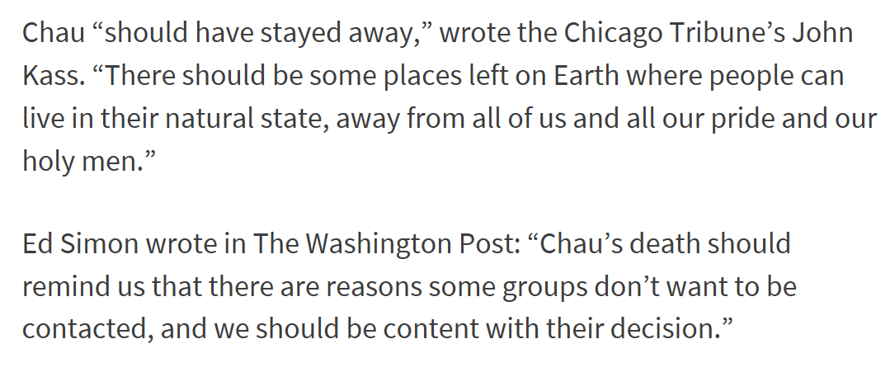

Slide 8
You guys might think I’m crazy in all this, but I think it’s worth it to declare Jesus to these people.” Chau told his parent sin a letter shortly before his death, according to the Guardian.
“This is not a pointless thing,” he added “The eternal lives of this tribe is at hand and I can’t wait to see them around the throne of God worshipping in their own language, as Revelation 7:9-10 states.”

Slide 9
John 17.13-19
I am coming to you now, but I say these things while I am still in the world, so that they may have the full measure of my joy within them. I have given them your word and the world has hated them, for they are not of the world any more than I am of the world. My prayer is not that you take them out of the world but that you protect them from the evil one. They are not of the world, even as I am not of it. Sanctify them by the truth; your word is truth. As you sent me into the world, I have sent them into the world. For them I sanctify myself, that they too may be truly sanctified

Slide 10
1st Feature of Missions - Joy
John 17:13 - But now I come to You; and these things I speak in the world so that they may have My joy made full in themselves.
Jesus’ mission is the context of “these things I speak…”
V4 “…accomplished the work you gave me to do”
v6 “manifested/revealed your name to the people…”
v11 “I am no longer in the world…I am coming to you”
Heb 12:2 - “Jesus…who for the joy set before Him endured the cross, despising the shame, and has sat down at the right hand of the throne of God”
Children know this!
They love epic stories
They think about their future in terms of mission

Slide 11
2nd Feature of Missions - Power
John 17:18 - As You sent Me into the world, I also have sent them into the world
Gen 12:2 - “I will make you a great nation, and I will bless you and make your name great…”
“so that you will be a blessing…”
Gen 12:1 - “Go from your country…”

Slide 12
How BIG is this purpose?
Gen 12.2-3
“…I will bless you…and all people on earth will be blessed through you.”

Slide 13
How BIG is this purpose?
Luke 24.46-47
"This is what is written: The Messiah will suffer and rise from the dead on the third day, and repentance for the forgiveness of sins will be preached in his name to all nations, beginning at Jerusalem."

Slide 14
How BIG is this purpose?
Luke 24.46-47
"This is what is written: The Messiah will suffer and rise from the dead on the third day, and repentance for the forgiveness of sins will be preached in his name to all nations, beginning at Jerusalem."
Isaiah 49.6 "It is too small a thing for you to be my servant to restore the tribes of Jacob and bring back those of Israel I have kept. I will also make you a light for the Gentiles, that my salvation may reach to the ends of the earth."

Slide 15
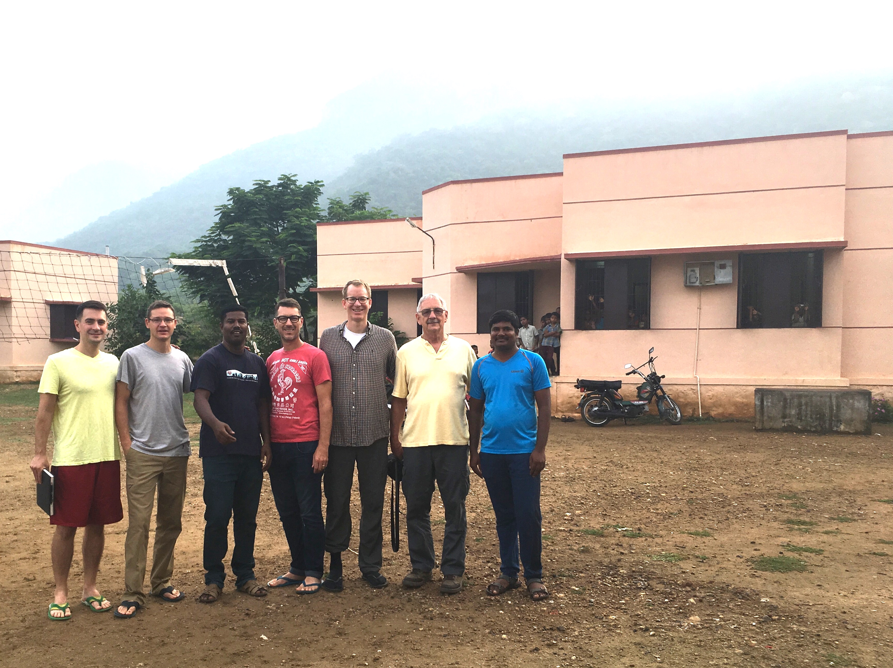
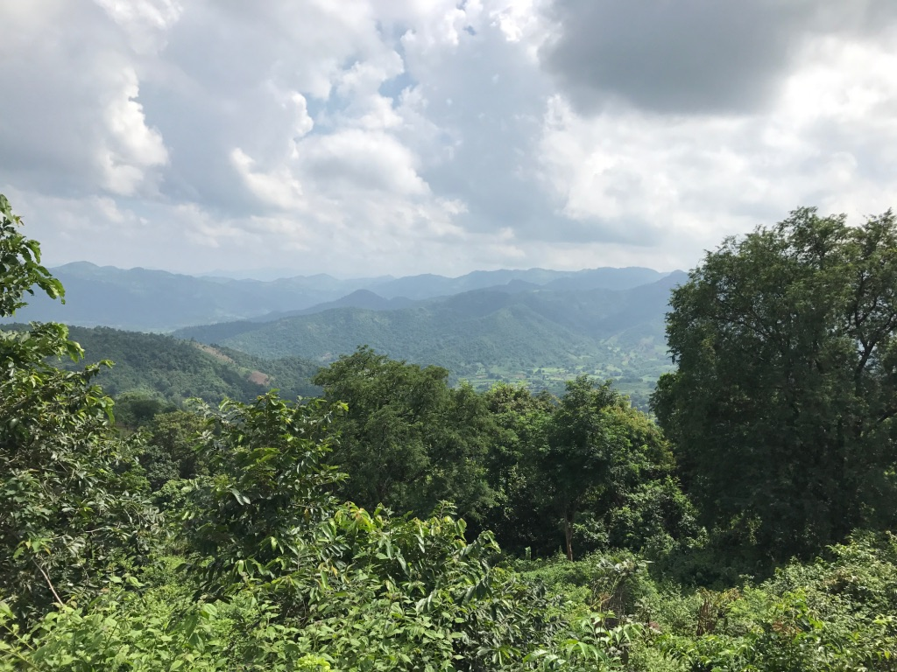
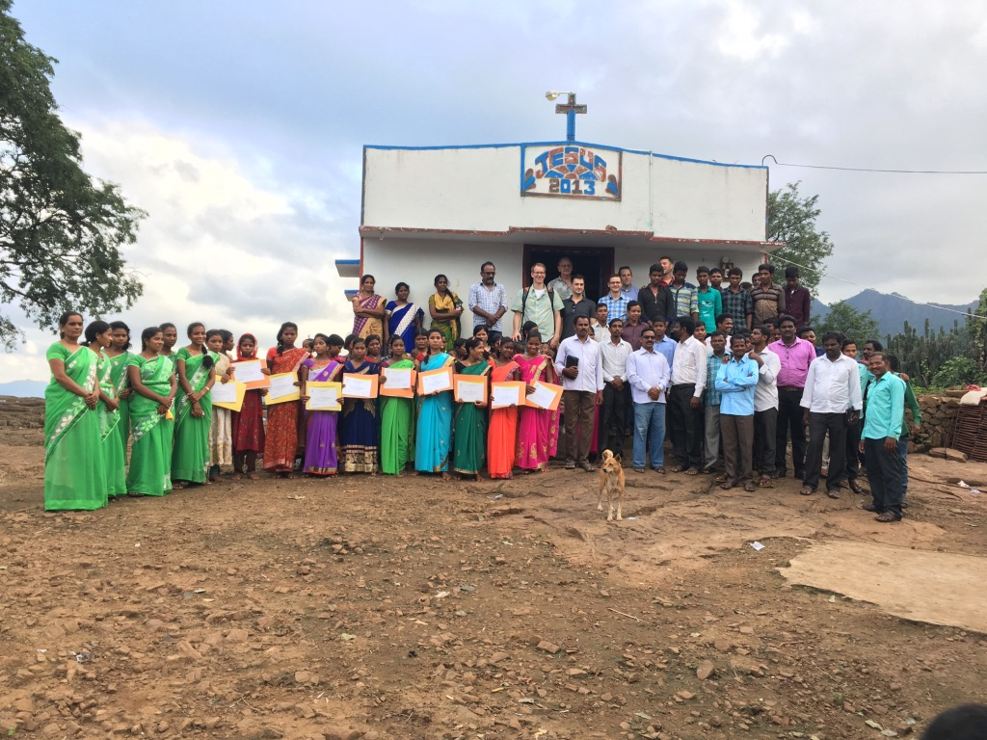
It’s Happening…

Slide 16
BIG starts small

Slide 17
BIG starts small
Not if, how
What is God calling you to?
Let God change you

Slide 18
BIG starts small
Not if, how
What is God calling you to?
Let God change you
Go
Give
Disciple
Prayer
What more?

Slide 19
This Photo by Unknown Author is licensed under CC BY-SA
This Photo by Unknown Author is licensed under CC BY-NC-ND

Slide 20

This Photo by Unknown Author is licensed under CC BY-SA
This Photo by Unknown Author is licensed under CC BY-NC-ND

Slide 21
Do Something BIG
Be with and like God
Connect Go
Joy

